Slide 1
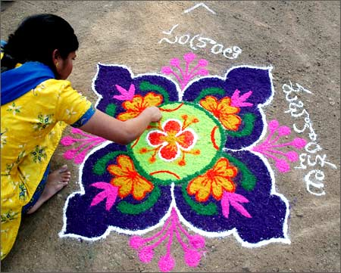
Happy Makar Sankranti

Slide 2
Why we celebrate Makar Sankranti
Makar Sankranti is a major Harvest festival celebrated in various parts of India.
Sankranti marks the termination of winter season and beginning of a new harvest or spring season.

Slide 3
Different names for the festival
Makar Sankranti or Sankranti - Andhra Pradesh, Bihar, Goa, Sikkim, Jharkhand, Karnataka, Kerala, Madhya Pradesh, Maharashtra, Manipur, Orissa, Uttar Pradesh, Uttarakhand, West Bengal and Uttarakhand.
Uttarayan- Gujarat and Rajasthan
Maghi - Haryana, Himachal Pradesh and Punjab
Pongal - Tamil Nadu
Magh Bihu or Bhogali Bihu - Assam Valley
Shishur Saenkraat - Kashmir Valley
Makara Vilakku Festival - Sabarimala Temple (Kerala)

Slide 4
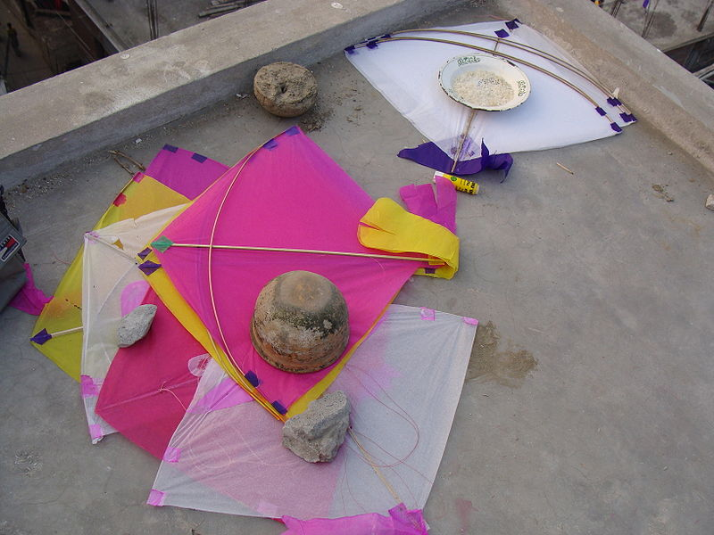
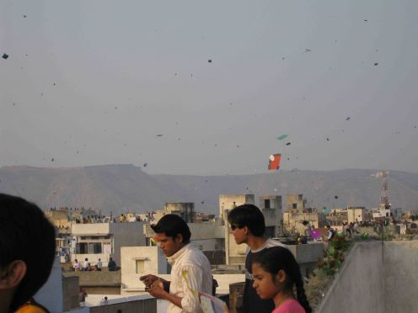
How do we celebrate Sankranti
Fly Kites

Slide 5
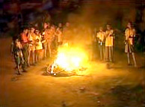
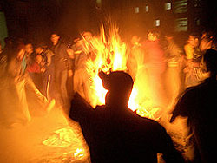
How do we celebrate Sankranti
Bhogi (Andhra Pradesh); Lohri (Punjab)

Slide 6
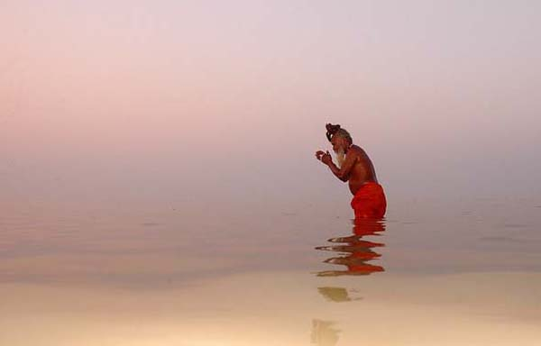
How do we celebrate Sankranti
People take bath in sacred river, Ganges

Slide 7
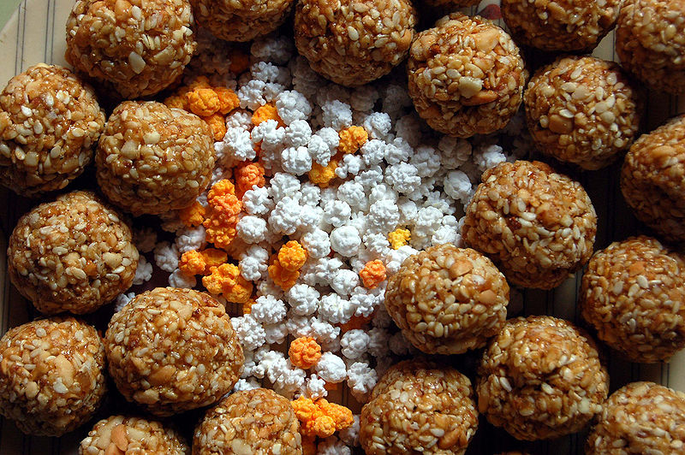
How do we celebrate Sankranti
Til-gul Ladoos

Slide 8
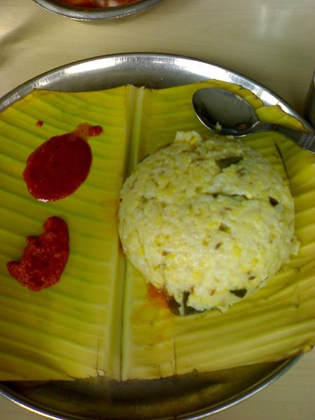
How do we celebrate Sankranti
Pongal

